Slide 1
Final project: Big Data Pipeline - Intelligent Job Matching with Real-Time ML Inference on AWS
Streamlining recruitment with automated ML-driven talent recommendations
Group 1: Chu-Chun Ku, Flavien Foreste, Mmesoma Udensi,
Yi-Ting Lee, Yun-Shan Chung

Slide 2
Agenda
01
03
ETL Design & Schema Decisions
Data Pipeline Architecture Diagram
Business Scenario
ML Model Creation Flow
Real-Time Talent Inference Flow
02
AWS Services Justification
04
05
07
Output, Visualizations, Insights
Execution Walkthrough
Demo videos
06
08
Security Considerations
Challenges, Solutions,
Limitations

Slide 3
Business Scenario: Real-Time Job Recommendation for Recruiters
Scenario:
I work for a global recruitment company building a smart talent-job matching platform. When a job seeker provides their skills, our ML model helps:
Predict the most suitable job title based on skills
Evaluate compatibility with their expected title using a matching score
This helps both recommend and validate job matches to speed up hiring decisions.
Goal:
Build a real-time ML-powered matching platform that:
Recommends suitable job titles based on user-provided skills
Assesses compatibility with expected titles via matching scores
This dual system supports recommendation + assessment, all automated in a scalable ETL pipeline.

Slide 4
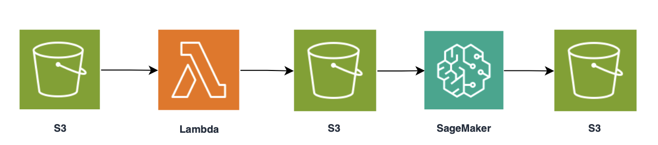
Data Pipeline Architecture Diagram
ML Model Creation Flow
Raw Job Data Ingestion
ETL Preprocessing
Model Training
Model Deployment
Upload job datasets to S3 for processing
Clean and merge raw data using Lambda → store cleaned data in S3
Save trained model to S3 for future deployment as an endpoint
Train ML model to predict job titles from skills
Next: Real-Time Talent Inference Flow

Slide 5
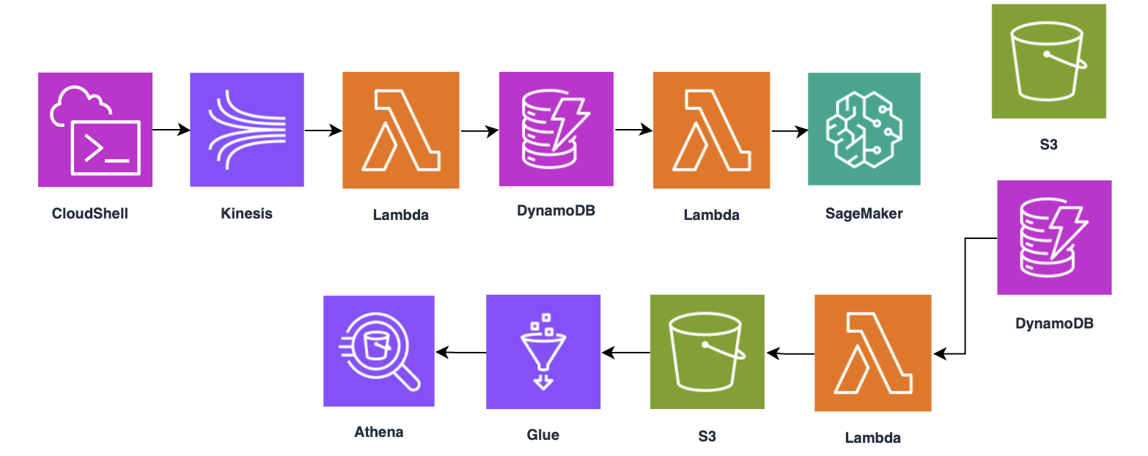

Data Pipeline Architecture Diagram
Real-Time Talent Inference Flow
ML Inference
Lambda sends job skills to SageMaker endpoint for prediction
Parse streaming data from Kinesis
and store into DynamoDB via Lambda
Talent Input Simulation
Streaming Ingestion
Save results to S3 and DynamoDB
Generate mock job skills and send to Kinesis stream
Glue Crawler catalogs S3 files; Athena runs queries and visualizes results
Data Query & Analysis
Full Sync to Unified CSV
Trigger Lambda on new results to consolidate predictions

Slide 6
AWS Services Justification
AWS Services Used & Why
Service | S3 | Lambda | SageMaker | Kinesis | DynamoDB | CloudShell | Glue | Athena
ML Model Creation | Stores raw, cleaned job datasets and trained ML models | Cleans and merges raw job data | Trains and deploys job recommend-ation model (Notebook + Endpoint)
Real-Time Talent Inference | Stores individual predictions and full results | Handle ingestion, inference, and aggregation | predict_lambda calls the endpoint to generate predictions and scores | Streams real-time talent input from CloudShell to Lambda | Stores unprocessed and predicted job data | Simulates real-time job seeker input | Crawler indexes prediction CSVs in S3 to enable querying | Queries and visualizes insights from predictions

Slide 7

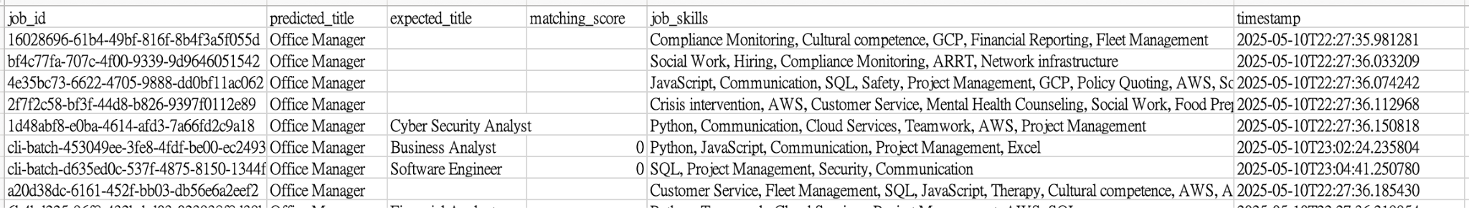
Cleaning, Merging, and Structuring Raw Job Data
ETL Design & Schema Decisions
ETL Process
Extract: Retrieve raw job datasets from S3 (linkedin_job_postings.csv & job_skills.csv)
Transform: job_data_cleaner_lambda merges the two files, removes null values, and standardizes fields like job_level and job_type.
Load: Cleaned data is saved to S3, then sampled and used in SageMaker Notebook to train the ML model.
Schema Decisions
job_skills is multi-valued and encoded using MultiLabelBinarizer.
cleaned_jobs.csv
Model predicted result

Slide 8
Batch Processing & Real-Time Streaming
Data ingestion details
ML Model Creation (Batch Mode)
Cleaned job data sampled_jobs.csv is used to train a job title prediction model in SageMaker Notebook.
Model is trained in batch, then exported and deployed as an inference endpoint.
Real-Time Talent Inference (Streaming Mode)
Talent data is simulated via CloudShell, streamed into Kinesis.
incoming-job-stream-lambda decodes and writes data to DynamoDB UnpredictedJobEvents
predict_lambda polls new items sends to SageMaker Endpoint for: → Job title prediction → Match score (if expected title provided)
Results stored in: DynamoDB: PredictedJobEvents S3: /predictions/{timestamp}.csv
sync_predictions_lambda aggregates all predictions data into S3 for Athena analysis.

Slide 9
IAM Policies, Bucket Protection, Data Access
Security Considerations
Security Overview: All services follow the principle of least privilege to ensure end-to-end data protection.
IAM Role Enforcement:
All Lambda functions and SageMaker endpoints operate under a shared, restricted IAM role (LabRole), ensuring controlled access to AWS services.
S3 Bucket Protection:
Buckets are private and accessible only via the assigned IAM role. Files are organized under structured prefixes: /raw/, /clean/, /model/, /predictions/, and /all_predictions/.
DynamoDB Streams Access:
Only the NewImage data from the PredictedJobEvents table is streamed to sync_predictions_lambda, limiting exposure to sensitive data.
CloudShell Input Simulation:
Talent input is simulated via CloudShell and sent to Kinesis. No privileged permissions are required beyond Kinesis write access.

Slide 10
Final outputs
Files | Description | Source / Generation Process | Purpose
cleaned_jobs.csv | Cleaned and merged job dataset (job_title, job_skills, etc.) | Generated by job_data_cleaner_lambda from raw LinkedIn datasets | Base dataset used for ML model training
sampled_jobs.csv | Filtered and sampled job records (only frequent titles kept) | Processed in Google Colab, sampled from cleaned_jobs.csv | Actual training dataset used for ML
job_title_model_v4.pkl skill_binarizer_v4.pkl model_v6.tar.gz inference6.py | Trained ML model, feature encoder, and inference code | Created in SageMaker Notebook, then uploaded to S3 | Used for deployment to SageMaker Endpoint for predictions
predictions/{timestamp}.csv | Per-candidate prediction results (one file per job_id) | Written by predict_lambda after inference | Individual prediction records for logging and traceability
all_predictions-{timestamp}.csv | Aggregated prediction results (full dataset) | Generated by sync_predictions_lambda from all DynamoDB records | Used for Glue crawler and Athena queries/analysis

Slide 11
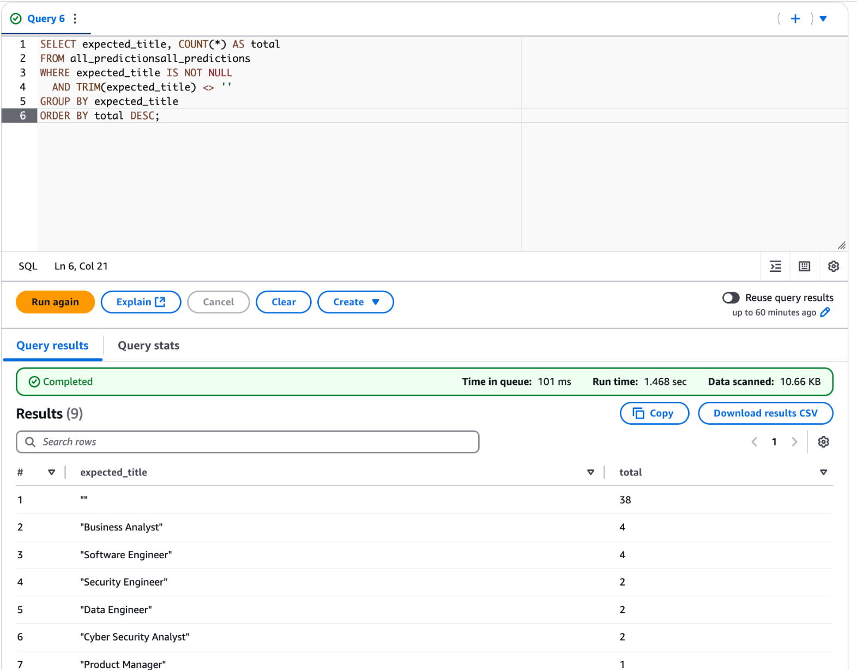
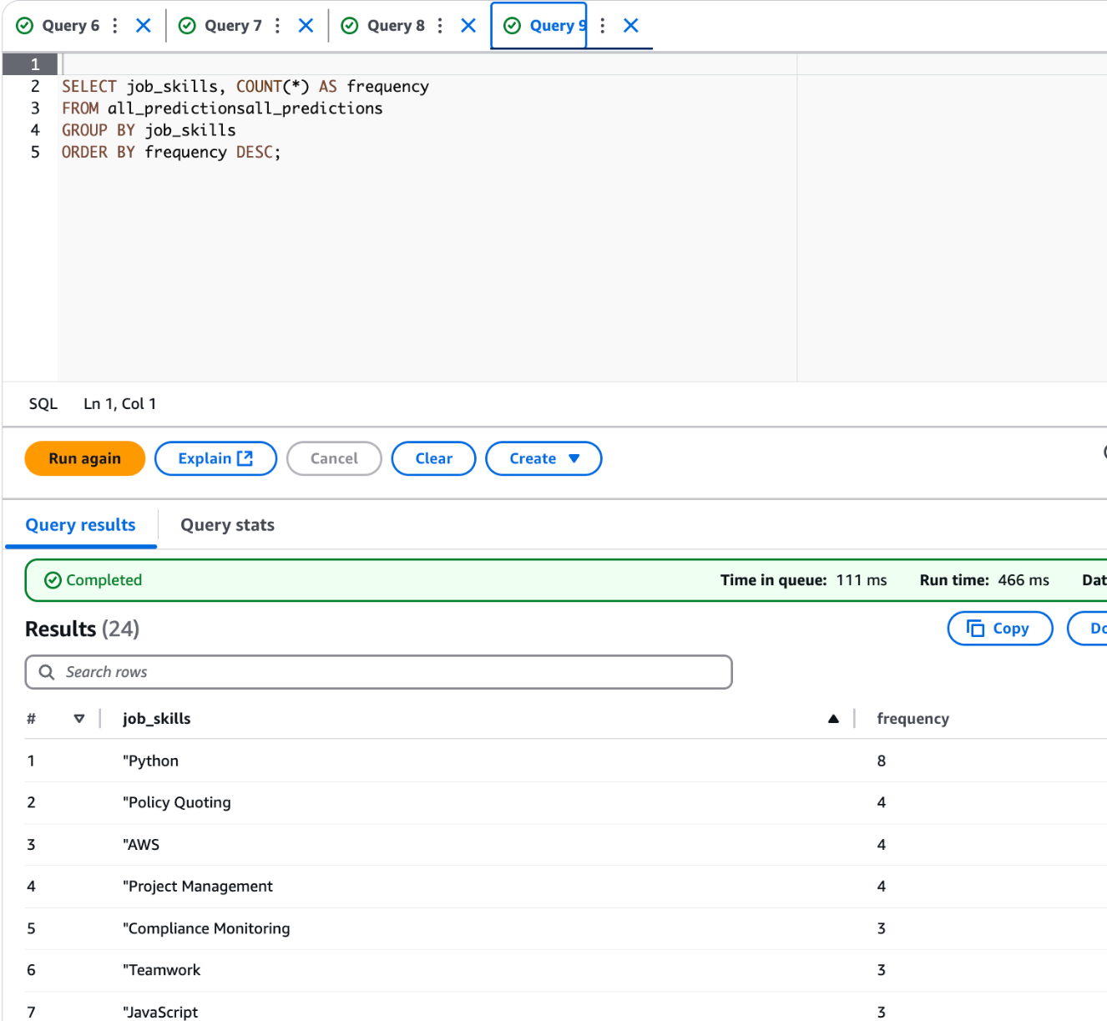
Visualizations & Insights
Top Expected Titles by Candidates
Identify in-demand roles based on expected titles
Helps recruiters understand job preference trends
Useful for setting performance targets
Most Common Job Skills
Reveals market skill trends
Informs salary benchmarks for high-demand skills
Helps tailor job requirements & training programs

Slide 12
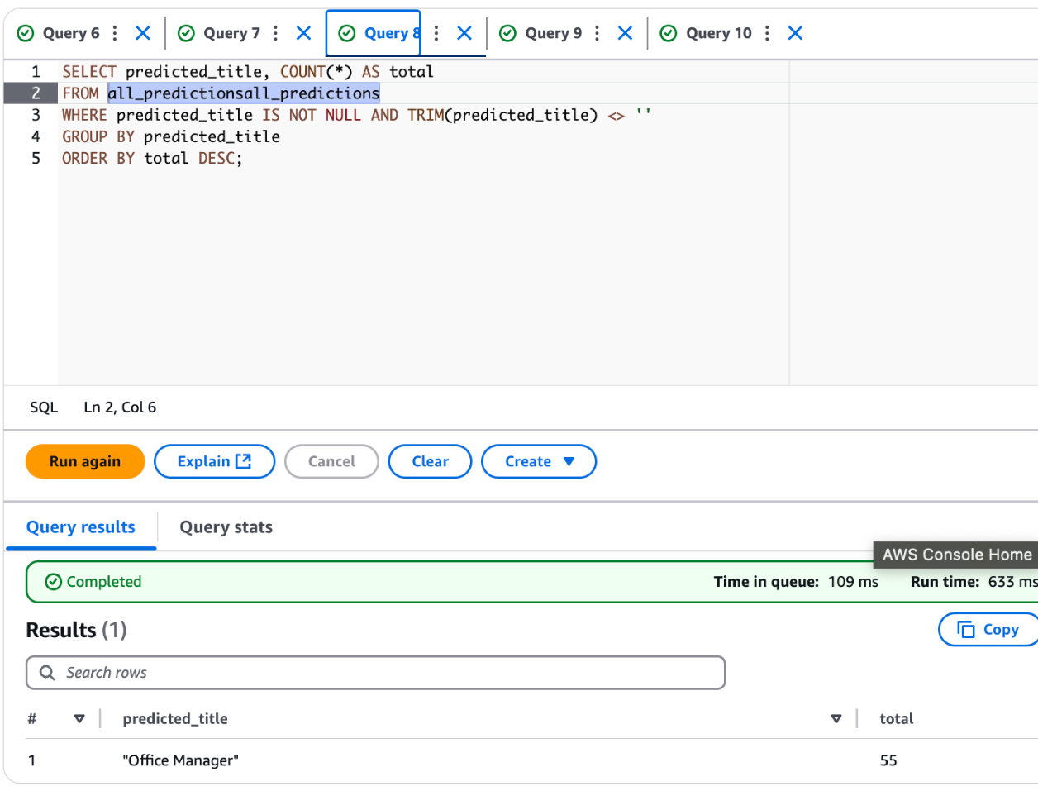
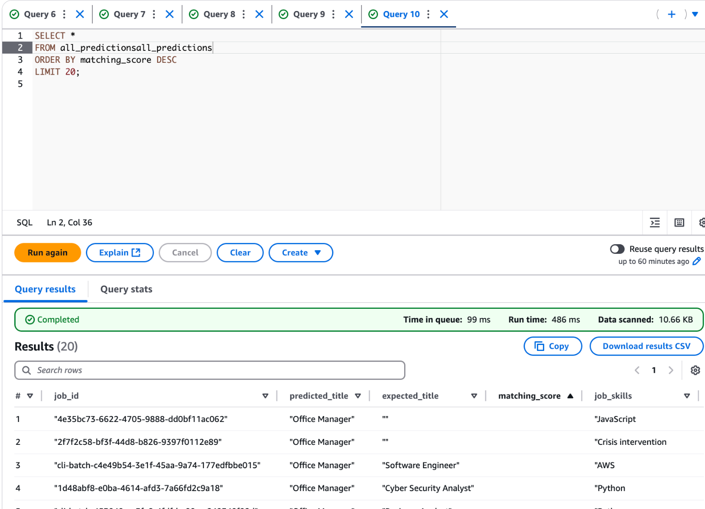
Visualizations & Insights
Most Predicted Job Titles
Shows which roles are most frequently recommended by the model
Helps prioritize talent pools for popular positions
Highest Matching Scores
Highlights best-fit candidates for their desired roles
Enables faster outreach and better-quality matches for recruiters

Slide 13
What Recruiters and Analysts Can Learn
Key Business Insights
Insight 1
Skill Distribution Reflects Market Trends
- Implication: High industry demand across sectors, (eg. Python, AWS, Project Management)
- Application:
> HR can prioritize these in job descriptions
> Guides training focus and salary benchmarks
Insight 2
"Office Manager" Prediction Dominance
- Issue: Disproportionate predictions toward "Office Manager"
- Cause: Likely due to imbalanced training data or broad job title variations
- Next Step:
> Rebalance training samples
> Improve title standardization
Insight 3
Fully Automated, Real-Time Pipeline
- Output: Real-time prediction + match score
- Benefit:
> Auto-stored in DynamoDB and S3
> System remains scalable and responsive under growth

Slide 14
Challenges & Solutions
Challenge | Solution
SageMaker model loading failed due to version incompatibility (pkl error) | Downgraded to scikit-learn==1.2.2, retrained and redeployed model
Lambda couldn't decode Kinesis base64 payloads | Added decoding logic with .decode("utf-8")
Multiple CSV prediction files made Athena queries complex | Used sync_predictions_lambda to consolidate into a single master CSV

Slide 15
Limitations
Model Training Constraints Cleaned dataset is around 1 million rows, exceeded SageMaker limits, even 50K / 20K / 5K subsets failed - Solution: Used 1,000 sampled records for training
Inconsistent Titles & Skills Job titles varied widely (e.g., "Software Engineer" vs "Engineer - Software") Some titles appeared only once — hard to classify Skills formatted inconsistently (e.g., "Problem Solving" vs "problem-solving") - Solution: Kept titles with ≥ 20 occurrences Used TF-IDF, top 5,000 terms to reduce noise
Low Prediction Diversity Most predictions were "Office Manager" Matching scores often 0.0 Indicates need for better data cleaning, label normalization, or larger training capacity

Slide 16
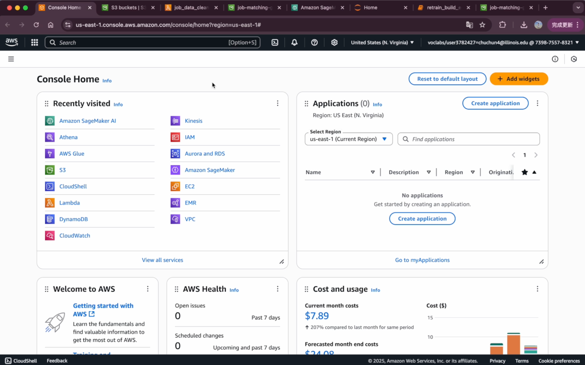
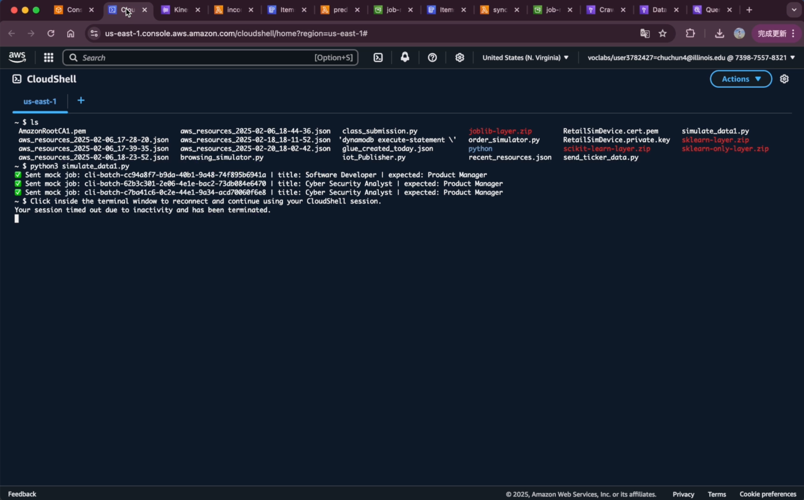
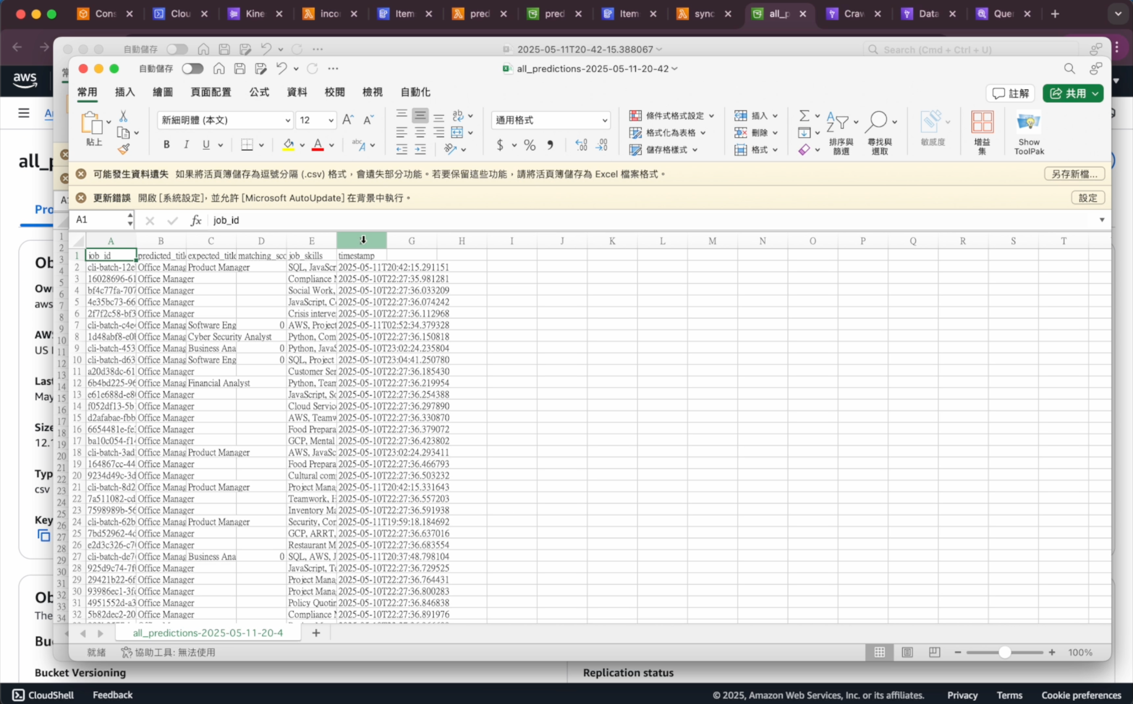



Execution Walkthrough
Demo video:
ML Model Creation Flow Demo.mp4
Real-Time Talent Inference Flow Demo.mp4
Live Inference Walkthrough_Real-Time Talent Inference Flow Demo.mp4

Slide 17
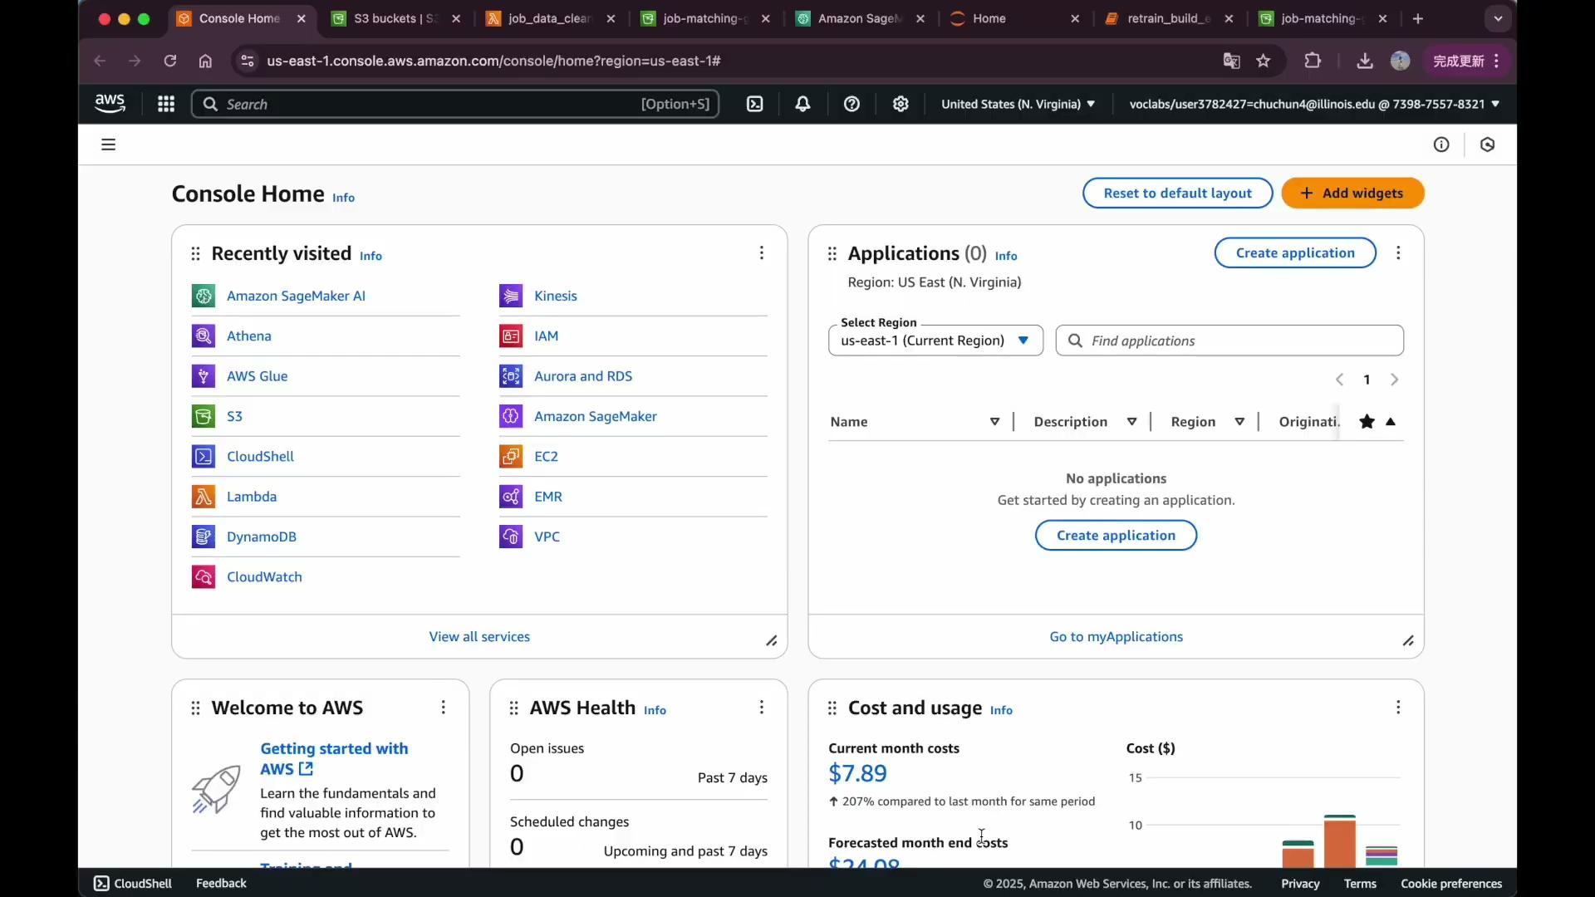
1. ML Model Creation Flow Demo.mp4

Slide 18
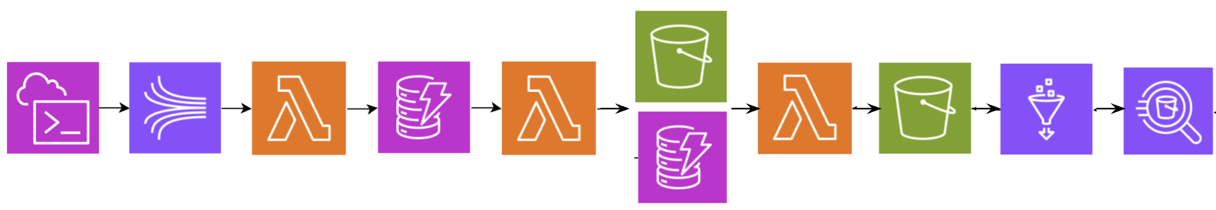

2. Real-Time Talent Inference Flow Demo.mp4

Slide 19
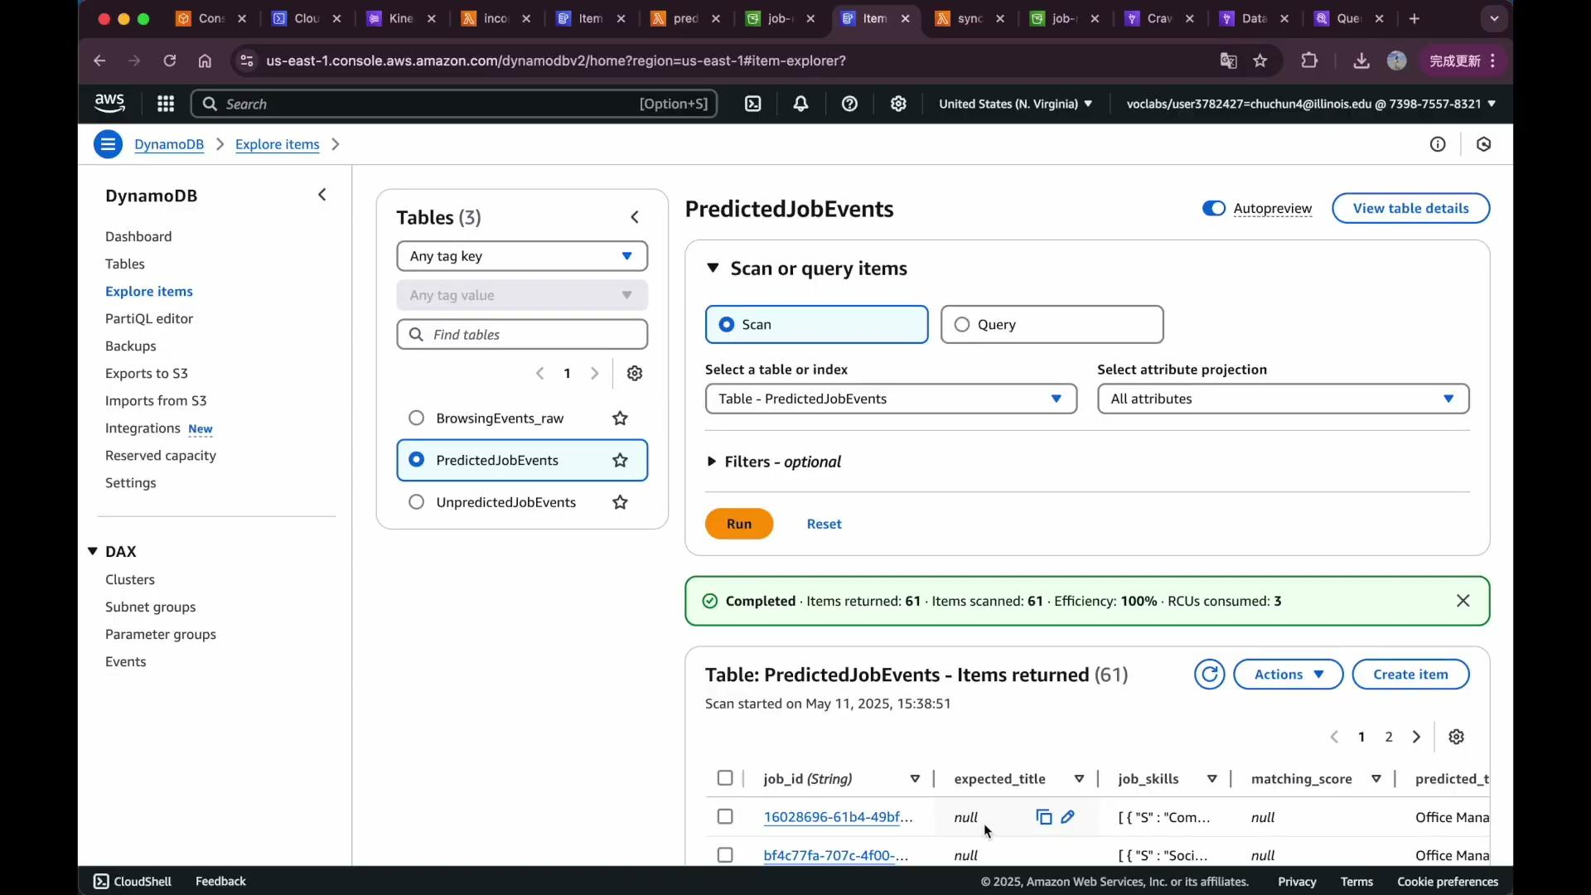
3. Live Inference Walkthrough Real-Time Talent Inference Flow Demo.mp4

Slide 20
Thank you!

